Slide 1
Recalculation of Calendar Year 2024
UI Employer Tax Rates
April 5, 2024
Portia Wu, Secretary
Jason Perkins-Cohen, Deputy Secretary
labor.maryland.gov

Slide 2
Webinar Settings
Please take a moment to look at the bottom of your screen for the Zoom webinar settings
To turn on captions or enter questions for our Q&A, please see the related buttons in the toolbar
Questions entered will be addressed at the end of the presentation
Please keep your camera off and mic muted

Slide 3
Background
In January, Division of Unemployment Insurance issued annual tax rate notices for Calendar Year 2024
Rates were based on an interpretation of MD statute treating a provision of pandemic relief as expired
At same time, state shifted from Tax Table C to Table A due to robust UI Trust Fund
Because Tax Table A has lower tax rates than Table C, most employers saw rate decrease due to table shift
But some employers saw increases due to pandemic relief expiration

Slide 4
Rate Recalculation
Based on further review, Division has reissued tax rates continuing pandemic relief for one more year
Some employers’ rate will go down due to the recalculation
No employers should see a tax rate increase

Slide 5
Rate Assignment
Division is now using same calculation method as past 2 years
Division compares two rate calculations, one based on pre-pandemic experience and one based on immediate past years’ experience
Assigns lower of two rates to employers

Slide 6
Timeline
Recalculated rates appeared in employer portal on Wednesday, March 27
Recalculated rate notices were posted in employer portal on Monday, April 1
Hard-copy notices with recalculated rates were mailed beginning Monday, April 1
Quarter 1 taxes are due April 30
Employers should pay Q1 taxes with recalculated rate

Slide 7
Credits and Refunds
If an employer has already paid their Q1 taxes and their rate is lowered by recalculation, they will receive a credit toward a future payment
If they prefer a refund, they may request a refund in BEACON employer portal

Slide 8
Tax Rate Recalculation
in Detail

Slide 9
Calculation of UI Tax Rates
Two factors influence an employer’s assigned tax rate:
The Tax Table assigned for the calendar year with the range of rates offered
Tax Table A assigned for 2024
The employer’s benefit ratio
Determines where an employer will fall along the range of Tax Table rates

Slide 10
Recalculation Process
The lower tax rate of the two methods is applied for 2024
Pre-Pandemic Experience
Normal Experience
Used rating years 2017, 2018, and 2019
Period used between July 1 - June 30 of each year
Used rating years 2021, 2022, and 2023
Period used between July 1 - June 30 of each year

Slide 11
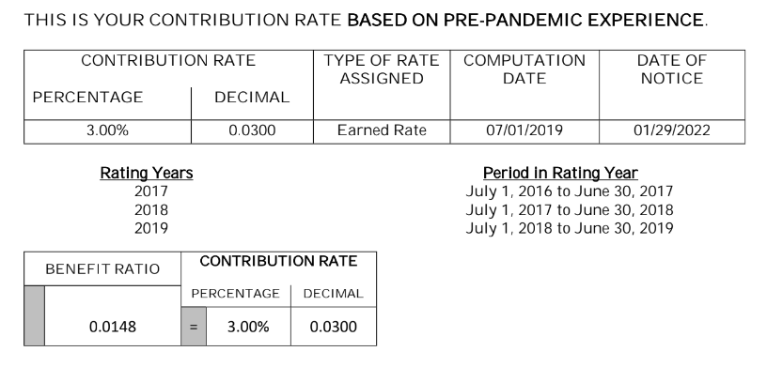
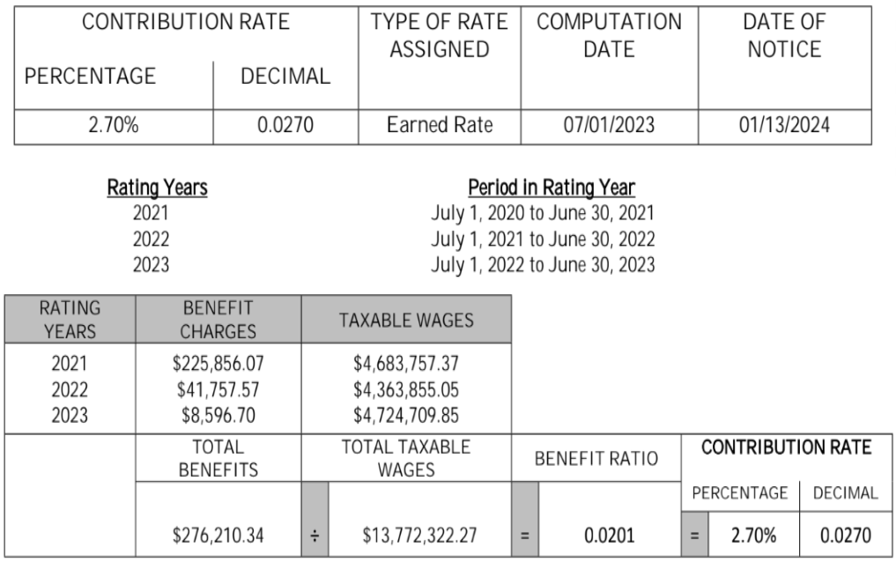
Example Rate Notice Calculation
*This is the lower rate

Slide 12
Checking a Rate Change in BEACON
To check if your rate has changed
Click “Tax Rate Functions” in the menu on the left side of your employer portal,
Select “2024” in the dropdown, and
Click “Search”

Slide 13
Withdrawal of Protests or Appeals
Some employers have already filed a protest or appeal about their 2024 tax rates
Determination reviews can be withdrawn by emailing dluicdexperiencerating-labor@maryland.gov
Appeals can be withdrawn in the employer portal, by emailing uilowerappeals.labor@maryland.gov, or by mail

Slide 14
Questions?
FAQs on rate recalculation will be available at: https://labor.maryland.gov/employment/unemployment.shtml
For questions about rates:
Employer Assistance Line at 410-949-0033
Toll free at 1-800-492-5524
Email at dluiemployerassistance-labor@maryland.gov
BEACON employer portal for more employer account details: https://employer.beacon.labor.md.gov

