Slide 1

Conference Center at the Maritime Institute
Friday, January 26, 2018 │ 692 Maritime Blvd, Linthicum Heights, Maryland

Slide 2
Today’s Agenda
8:00 – 9:00 AM | Registration and Continental Breakfast
9:00 – 9:45 AM | Welcome and Introductions Auditorium
9:45 – 11:00 AM | General Session Auditorium Nondiscrimination Plan (draft) Workforce System Survey Language Access Plan (draft) Monitoring and Compliance
11:15 – 12:00 PM | Breakout Session #1
12:15 – 1:45 PM | Working Lunch Chesapeake Dining Room
2:00 – 2:45 PM | Breakout Session #2
3:00 – 3:45 PM | Breakout Session #3

Slide 3





WELCOME FROM LEADERSHIP
Secretary Kelly Schulz
Secretary Carol Beatty
Secretary Lourdes Padilla
Assistant State Superintendent Suzanne Page
Chairman Louis Dubin

Slide 4
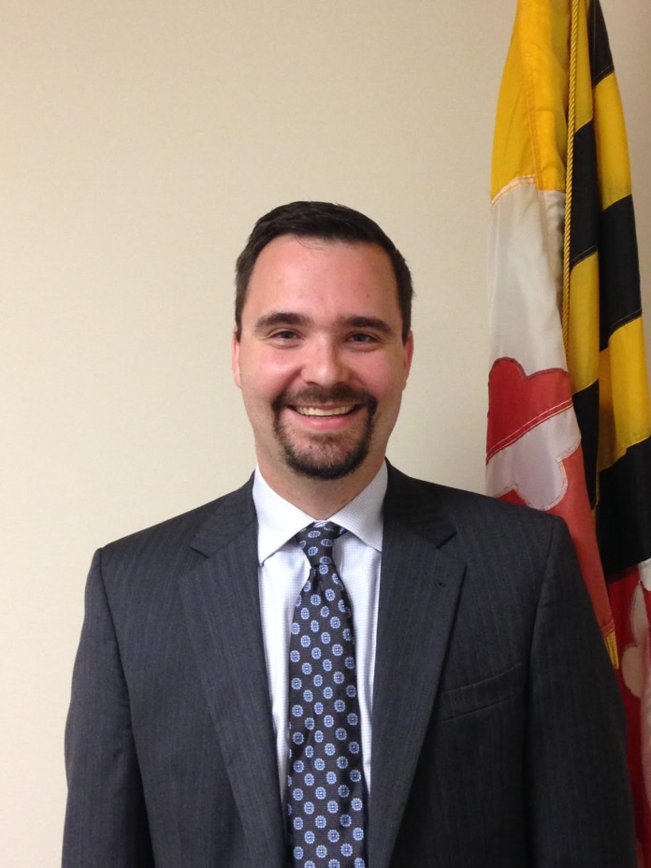
Overview: Maryland’s Nondiscrimination Plan (draft) under the Workforce Innovation and Opportunity Act
Brandon Butler
Deputy Assistant Secretary
Division of Workforce Development and Adult Learning (DWDAL)
Department of Labor, Licensing and Regulation (DLLR)

Slide 5

Title slide.
Maryland’s Workforce System’s
Pathway to Providing Opportunity for All Marylanders

Slide 6

Why am I here?
Brandon is presenting. Why else would I come?

Slide 7


Slide 8

Pathway to Providing Opportunity for All Marylanders

Slide 9
Slide 2
Require-ments
of Section 188.
02
01
03
The State Non-Discrimination Plan (draft)
How we got here
Overview of Maryland’s Workforce System
04
What you’re going to see the rest of the day

Slide 10
Slide 1
August 2016
Local Plans were submitted to the State.
December 2016
Memoranda of Understanding Expired
July 2015
The Workforce Innovation and Opportunity Act enacted in Congress.
January 2017
Adult Education competition released.
April 2016
State Workforce Plan submitted to federal partners
July 2017
Resource Sharing / Infrastructure Agreements .

Slide 11
Actually we did so much more…
April 1, 2016 Plan submission
April 20, 2016 MD releases guidance for local & regional plans
July 1, 2016 All MOUs are extended to Dec. 31, 2016
Sept 28, 2016 Local performance negotiations completed for Title I and Title III
Aug 31, 2016 Local plans submitted to the State
Oct 1, 2016 State Plan finally approved by feds
Dec 7, 2016 GWDB conditionally approves Local Plan
Dec 14, 2016 Letters sent to Local Areas
Dec 31, 2016 MOUs due
Jan 17, 2017 Adult Education Competition
March 31, 2017 Regional Planning Submitted
June 14, 2017 All Regional and Local Plans approved
July 30, 2017 RSA, One-Stop Operator Procurement

Slide 12

Compliance Fatigue

Slide 13
The greatest thing Kirk Murray has ever said
“When can we get through all of this compliance stuff and get to innovating?”
-Loosely quoted from the Great Kirk Murray,
President and Supreme Overlord of the Maryland Workforce Association
“You know, man, Kirk stole this from me!”
-Dan McDermott

Slide 14
The State Workforce Plan 2016
First time in Maryland’s history that the workforce development activities of three State agencies is produced in one document
Emphasizes customer-service, government efficiency, and how Maryland can meet the needs of businesses and all of the State’s jobseekers
Governor’s Workforce Investment Board approved the plan on February 11, 2016
Submitted to federal agencies on April 1, 2016 and finally approved October 1, 2016.

Slide 15

Placing People Before Performance
Placing people before performance means that Maryland’s workforce system is dedicated to focusing its efforts on those who need our assistance the most….
This strategy does not mean that Maryland is going to forsake all performance measures. Rather, it requires a change in focus from numbers and figures on a page to people who walk through the doors of any one of Maryland’s American Job Centers, local Department of Social Services offices, or other local career centers. It means that Maryland’s workforce system is dedicated to improving the lives of Marylanders.

Slide 16
Slide 4
Who is walking into our centers?
Holistic view of our “common customer”
Interpersonal Relationships
Essential Workplace Skills
Career Navigation
Difficulty navigating the system
Family Issues
Basic Skills
Housing Issues
Life Skills

Slide 17
Why am I here?
I thought this was a conference on nondiscrimination.

Slide 18

The WIOA Regulations
June 30, 2016 – 4143 pages of regulations implementing WIOA were released
December 2, 2016 – 114 pages of regulations implementing Section 188 of WIOA were also released

Slide 19
Applicability
§ 38.2 Applicability.
This part applies to:
Any recipient, as defined in § 38.4;
(2) Programs and activities that are part of the one-stop delivery system and that are operated by one-stop partners listed in section 121(b) of WIOA, to the extent that the programs and activities are being conducted as part of the onestop delivery system; and
(3) As provided in § 38.18, the employment practices of a recipient and/or one-stop partner, to the extent that the employment is in the administration of or in connection with programs and activities that are being conducted as a part of WIOA Title I or the one-stop delivery system.

Slide 20
Recipients
Recipient means entity to which financial assistance under Title I of WIOA is extended, directly from the Department or through the Governor or another recipient (including any successor, assignee, or transferee of a recipient).
The term excludes any ultimate beneficiary of the WIOA Title I-financially assisted program or activity. In instances in which a Governor operates a program or activity, either directly or through a State agency, using discretionary funds apportioned to the Governor under WIOA Title I (rather than disbursing the funds to another recipient), the Governor is also a recipient.
In addition, for purposes of this part, one-stop partners, as defined in section 121(b) of WIOA, are treated as ‘‘recipients,’’ and are subject to the nondiscrimination and equal opportunity requirements of this part, to the extent that they participate in the one-stop delivery system.

Slide 21
Recipients
‘‘Recipient’’ includes, but is not limited to:
  State-level agencies that administer, or are financed in whole or in part with, WIOA Title I funds;
  State Workforce Agencies;
  State and Local Workforce Development Boards;
  LWDA grant recipients;
  One-stop operators;
  Service providers, including eligible training providers;
  On-the-Job Training (OJT) employers;
  Job Corps contractors and center operators;
  Job Corps national training contractors;
  Outreach and admissions agencies, including Job Corps contractors that perform these functions;
  Placement agencies, including Job Corps contractors that perform these functions; (12) Other National Program recipients.

Slide 22

Section 121 of WIOA

Slide 23
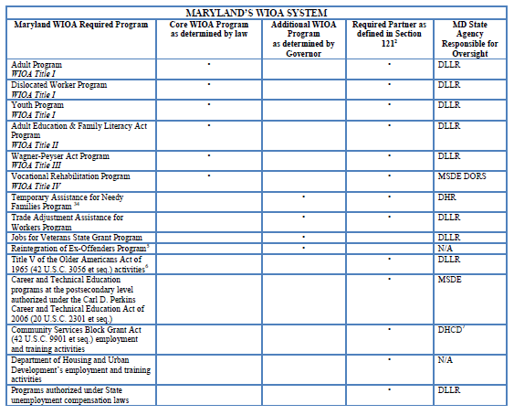

Slide 24

The Nondiscrimination Plan (draft)
No, that is not a young Terry Gilleland

Slide 25
Plan Requirements
At a minimum, each Nondiscrimination Plan must:
(1) Describe how the State Programs and recipients have satisfied the requirements of the following regulations:
(i) Sections 38.25 through 38.27 (Assurances);
(ii) Sections 38.28 through 38.33 (Equal Opportunity Officers);
(iii) Sections 38.34 through 38.39 (Notice and Communication);
(iv) Sections 38.41 through 38.45 (Data and Information Collection and Maintenance);
(v) Section 38.40 (Affirmative Outreach);
(vi) Section 38.53 (Governor’s Oversight Responsibility Regarding Recipients’ Recordkeeping);
(vii) Sections 38.72 and 38.73 (Complaint Processing Procedures); and
(viii) Sections 38.51 and 38.53 (Governor’s Oversight and Monitoring Responsibilities for State Programs).
(2) Include the following additional elements:
(i) A system for determining whether a grant applicant, if financially assisted, and/or a training provider, if selected as eligible under Section 122 of WIOA, is likely to conduct its WIOA Title I financially assisted programs or activities in a nondiscriminatory way, and to comply with the regulations in this part;
(ii) A review of recipient policy issuances to ensure they are nondiscriminatory;
(iii) A system for reviewing recipients’ job training plans, contracts, assurances, and other similar agreements to ensure that they are both nondiscriminatory and contain the required language regarding nondiscrimination and equal opportunity;
(iv) Procedures for ensuring that recipients comply with the nondiscrimination and equal opportunity requirements of § 38.5 regarding race, color, religion, sex (including pregnancy, childbirth, and related medical conditions, transgender status, and gender identity), national origin (including limited English proficiency), age, political affiliation or belief, citizenship, or participation in any WIOA Title I-financially assisted program or activity;

Slide 26
“The update ensures the entire workforce system is aware of current equal opportunity rights and responsibilities of beneficiaries and recipients. This regulation will also increase equality of opportunity for millions of job seekers, training participants, program beneficiaries, and recipients' employees by allowing them to participate or work in programs and activities free from unlawful discrimination. The final rule safeguards access to the system in particular for people with disabilities, people with limited English proficiency, transgender individuals who may face various forms of sex discrimination, and individuals who are pregnant, have had a child, or have related medical conditions.”
-USDOL CRC Announcement of Section 188 Regulations

Slide 27
Slide 4
Who is walking into our centers?
Holistic view of our “common customer”
Interpersonal Relationships
Essential Workplace Skills
Career Navigation
Difficulty navigating the system
Family Issues
Basic Skills
Housing Issues
Life Skills

Slide 28




For the rest of the day…
Maryland’s Draft
Nondiscrimination Plan
Ensuring Language Access
Providing Opportunities for Those with Disabilities
Monitoring

Slide 29





Benchmarks for Success
Maximizing Employment Opportunities
Maximizing Skills and Credentialing
Maximizing Life Management Skills
Eliminating Barriers to Employment
Enhancing the Efficiency of Maryland’s Workforce System

Slide 30

“When can we get through all of this compliance stuff and get to innovating?”

Slide 31

The Workforce System Survey to Assess WIOA Network Capacity to Serve Skilled Immigrants and LEP Individuals
Augustin Ntabaganyimana
Acting Director, Office of Grants Management
Maryland Office for Refugees and Asylees (MORA)
Department of Human Services (DHS)

Slide 32

The Workforce System Survey:
Assessing WIOA Network Capacity to Serve Skilled Immigrants and LEP Individuals
Third WIOA Convening: Providing Opportunities for All Marylanders
January 26, 2018 | Maritime Institute
Augustin Ntabaganyimana, Acting Director, Office of Grants Management
Maryland Office for Refugees and Asylees (MORA)
Maryland Department of Human Services (DHS)

Slide 33
Workforce System Survey
Purpose: Assess the capacity of the MD workforce system to serve Limited English Proficient (LEP) individuals and skilled immigrants
Developed out of the work of the Capacity Building and Best Practices subcommittee in the first year of the Maryland Skilled Immigrant Task Force
Disseminated in August of 2017 to leadership and frontline staff at the following:
  American Job Centers (AJCs)
  Local Department of Social Services (LDSS)
  Division of Rehabilitation Services (DORS)
  WIOA Title II adult education in all 12 Local Workforce Development Areas of Maryland

Slide 34
Workforce System Survey 101
Anonymous to allow for honest results
Disseminated via Google Forms
Largely multiple choice along with 4 open-ended questions
Multiple choice questions often included an open-ended “other” option, where respondents could write in their own answer
All of the questions in the survey were optional, so there was an implicit “not applicable” option (e.g. not applicable to my job function) by skipping the question
Full Survey available online at: https://www.dllr.state.md.us/employment/skilledimmigrant.shtml

Slide 35
Professional Demographics

Slide 36
Organizations Represented in Survey Results

Slide 37
Local Workforce Development Areas Represented

Slide 38
Job Functions of Respondents

Slide 39
Limited English Proficiency (LEP)
Individuals who do not speak English as their primary language and who have a limited ability to read, speak, write, or understand English can be limited English proficient.
LEP individuals may be competent in English for certain types of communication (e.g., speaking or understanding), but still be LEP for other purposes (e.g., reading or writing).

Slide 40
Time at which language assistance training is available for staff

Slide 41
Skilled Immigrant
A work-authorized foreign-born and foreign-trained worker with at least two (2) years of formal or informal education, training, or on the job experience that has led to special skills, training, knowledge, and/or abilities for certain types of work

Slide 42
What are the barriers preventing skilled immigrants from returning to their previous occupation?

Slide 43

Overview: Draft LAP for the Division of Workforce Development and Adult Learning and the Division of Unemployment Insurance
Lauren Gilwee
New Americans Initiative Coordinator
Division of Workforce Development and Adult Learning (DWDAL)
Department of Labor, Licensing and Regulation (DLLR)

Slide 44

Language Access Plan (draft)
Lauren Gilwee
New Americans Initiative Coordinator

Slide 45
Development and Timeline
Developed
  in conjunction with the Nondiscrimination Plan
Drafted and released
  for public comment August 2017- January 2018
Pursuant to
  Section 188 of Workforce Innovation and Opportunity Act (WIOA)
  Md. STATE GOVERNMENT Code Ann. §§ 10-1101-10-1103
  DLLR’s Office of Fair Practices

Slide 46

Why is the LAP being created now?
Commitment to excellent customer service
Prioritizing “people over performance”
Guidance following results of the Workforce System Survey
Ensuring compliance for federally-funded programs

Slide 47

Stakeholder Consultation
Adult Education Providers
Division of Unemployment Insurance
Local Workforce Development Areas
Division of Workforce Development and Adult Learning
Notes:
The LAP

Slide 48
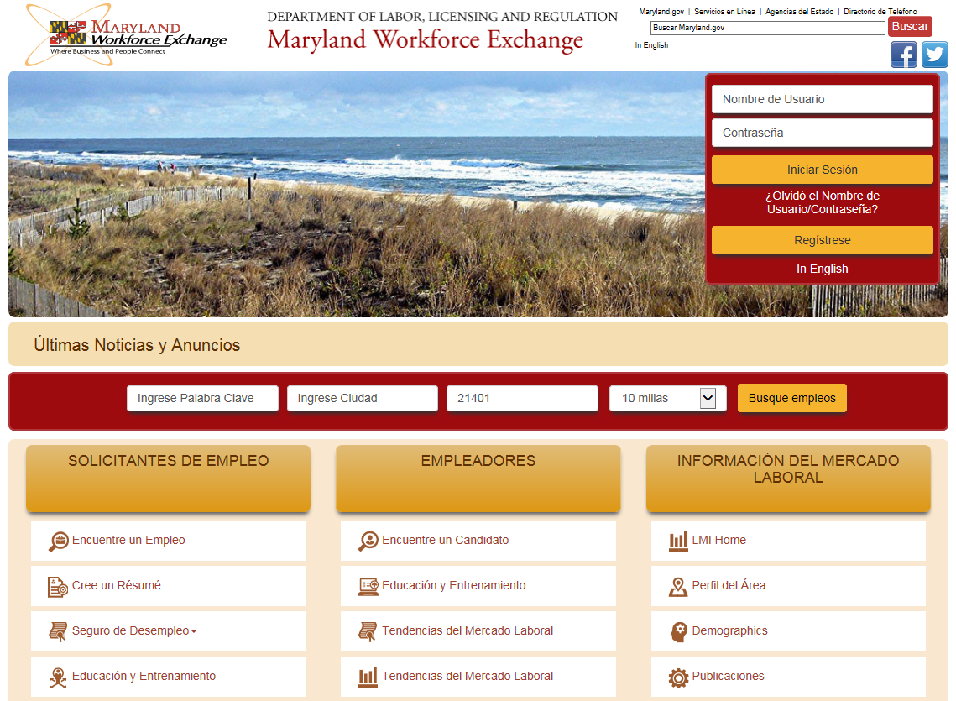
Examples of Progress
Maryland Workforce Exchange available En Español

Slide 49
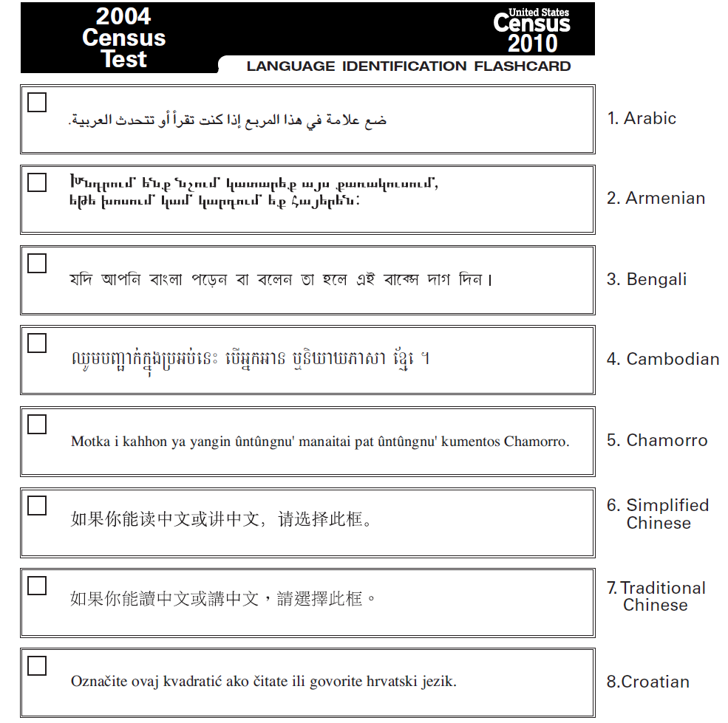
Use of multilingual
I Speak cards at the American Job Centers

Slide 50


Important
Implications

Slide 51

Oral Interpretation
Multilingual staff and volunteers
Telephone interpretation
In-person interpretation

Slide 52
Vital Documents
Definition and procedures to identify
Common examples
Babel Notices
Translation services

Slide 53

Next Steps
Guidelines and Procedures
Staff Training
Monitoring
Support

Slide 54
Questions about the (draft) LAP?
  Lauren Gilwee
  New Americans Initiative Coordinator
  lauren.gilwee@maryland.gov
  410-767-2268

Slide 55


Slide 56

WIOA Section 188: Compliance Planning and Deadlines
Tanya Washington
Monitoring and Compliance Manager
Division of Workforce Development and Adult Learning (DWDAL)
Department of Labor, Licensing and Regulation (DLLR)

Slide 57



Division of Workforce Development
and Adult Learning (DWDAL)
Kelly M. Schulz, Secretary of Department of Labor, Licensing & Regulation
David McGlone, Deputy Secretary
James Rzepkowski, Assistant Secretary DWDAL

Slide 58
Monitor’s Purpose
The purpose of the Workforce Innovation and Opportunity Act (WIOA) monitoring is to ensure the integrity of the Workforce system and assess the compliance with applicable laws and regulations, and to identify successful methods and best practices that serve to enhance the programmatic system and internal controls of Local Workforce Development Areas.

Slide 59
We are…organized into two major components - Programmatic and Fiscal
The Monitoring and Compliance (M&C) Unit is primarily responsible for managing the Division of Workforce Development and Adult Learning’s program compliance as a whole. The basic functions of the Unit include:
Monitoring and Oversight of federal program finances and activities;
Implementing Corrective Actions;
Providing Technical Assistance;
Serve as Consultants to the Local areas;
Safeguarding the WIOA financial system from the abuses of financial crime, and other illicit activity;
Enforcing program and federal finance laws under Uniform Guidance; and
Ensuring compliance in regards to ACCESS to all programs.

Slide 60


Our Guides
WORKFORCE INNOVATION AND OPPORTUNITY ACT
TEGLs – Training & Employment Guidance Letters
US DOL
State of Maryland
Local Government

Slide 61
Monitoring Process Cycle
Plan Visit & Notification to LWDA
Desk Review
Comprehensive Onsite Review
Report, Technical Assistance & Corrective Action Evaluation
End Cycle Visit
Follow-up

Slide 62

Monitoring Basics
Desk and Annual Onsite Reviews:
Design and Governance
Program and Grant Management
Financial Management Systems
Adult/Dislocated Worker Programs
Youth Programs
NEW: EQUAL OPPORTUNITY, DISABILITY ACCESS AND LANGUAGE ACCESS

Slide 63
What’s Next?
The Monitoring Report:
• Describes the goals, scope, and standards of the monitoring process
• Defines specific concerns, observations or findings
• Specifies the expected response or corrective action needed from the grantee
After the Onsite Visits and Desk Reviews - which support one another…
We take our working papers to develop a report highlighting the area observations.

Slide 64

Federal Requirements – Section 188
Additional Observations

Slide 65


29 CFR Part 38–All of the provisions, terms and conditions “Flow Down”
Depending on…
You will be responsible for outcome
OUTCOME/RESULTS

Slide 66
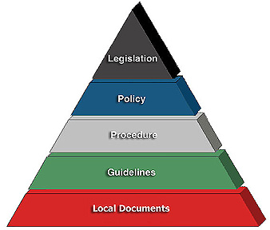
MARCHING ORDERS…
Final Rule
FEDERAL
STATE
LOCAL

Slide 67

NEW …29 CFR Part 38
HOW WE Ensure Equal Access to the Nation’s Workforce Development System
EQUAL OPPORTUNITY ACCESS
LANGUAGE ACCESS
DISABILITY ACCESS

Slide 68

Sub-Recipient’s Responsibilities
Train and Advise your staff & sub-recipients;
Implement a Discrimination Complaint Process
Develop and implement systems to ensure proper collection of data
  File and document management process
  Intake process
  Distribution of information and materials
  Monitoring activities
  Adherence to terms & conditions of award as well as TEGLs, statues, regulations and provisions

Slide 69
WHAT SHOULD YOU DO?
Every year create a schedule based on location of when YOU will review your region’s Language Access Plan and Nondiscrimination Plan.
Send notifications to comprehensive and satellite offices alerting them of the requirements for posters, Babel Notice, Interpreter Services and Outreach materials. Update as necessary!
Monitor each site once a year and conduct random check-ins as a courtesy.
Evaluate the risk posed by your Sub-recipient. You will be held accountable for many acts of noncompliance on the part of the Sub-recipient.
If you are a Local Government, follow your applicable administrative statutes, regulations, and State’s policy for Nondiscrimination.

Slide 70

Timeliness
Deadlines!

Slide 71
Scope OF IMPLEMENTATION OF SECTION 188 -DEADLINES
Types of Plans | Nondiscrimination FEBRUARY 2019 | Language Access Plan JANUARY 2019 | Disability Accessibility NOW | Equal Opportunity NOW
Frequency | Once a year | Once a year | Once a year | Once a year
Technical Assistance provided by… | State EO Officer and Monitors | State EO Officer, New American Initiative Coordinator and Monitors | Youth & Disabilities Coordinator and State EO Officer with some assistance from Monitors | State EO Office and Monitors
Number of Regions 12 | All | All | Randomly selected | All
Programs reviewed | All | All | All | All

Slide 72

A Rule of Thumb
Whenever you are contemplating a significant action relating to eligibility, and you are uncertain about the need, consult in advance with:
  Your DWDAL Monitor

Slide 73


We are here!
Our goal is to protect you and the State of Maryland’s interest.
Use your monitor to assist you!

Slide 74


Big Picture
Everyone should see the importance of WORKING TOGETHER.
THANK YOU!

Slide 75
Maryland Department of Labor, Licensing and Regulation
Division of Workforce Development and Adult Learning Contact Information
410.767.2173
Please submit questions to tanya.washington@maryland.gov.
For questions directly related to specific monitors please forward to:
Fiscal: marsha.harris@maryland.gov; alphonsus.ogbaekwe@maryland.gov;
Program: maryellen.branham@maryland.gov; greg.adams@maryland.gov
75

Slide 76
Today’s Agenda
8:00 – 9:00 AM | Registration and Continental Breakfast
9:00 – 9:45 AM | Welcome and Introductions Auditorium
9:45 – 11:00 AM | General Session Auditorium Nondiscrimination Plan (draft) Workforce System Survey Language Access Plan (draft) Monitoring and Compliance
11:15 – 12:00 PM | Breakout Session #1
12:15 – 1:45 PM | Working Lunch Chesapeake Dining Room
2:00 – 2:45 PM | Breakout Session #2
3:00 – 3:45 PM | Breakout Session #3

Slide 77
Conference Center at the Maritime Institute
Friday, January 26, 2018 │ 692 Maritime Blvd, Linthicum Heights, Maryland

